Slide 1
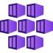
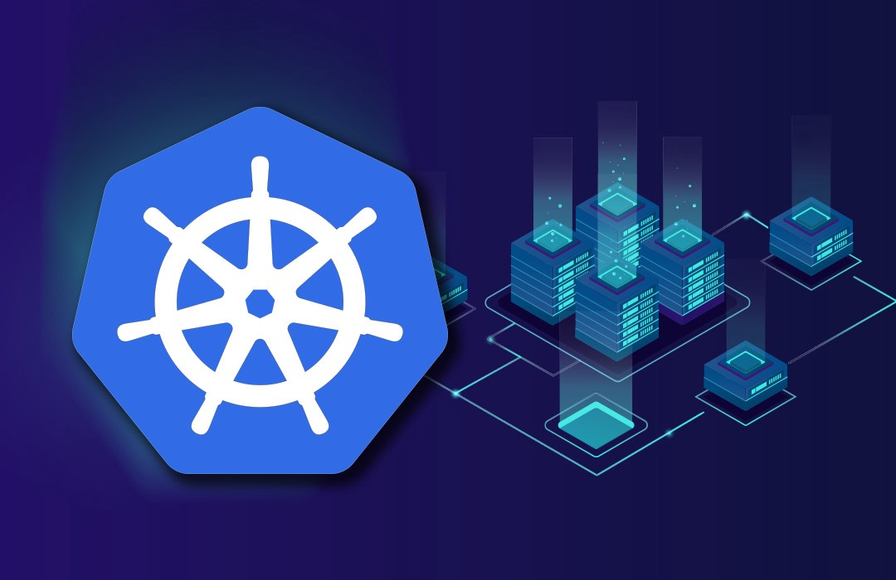


Intro to AKS & Kubernetes
Alaa Barqawi
AKS Support Microsoft

Slide 2
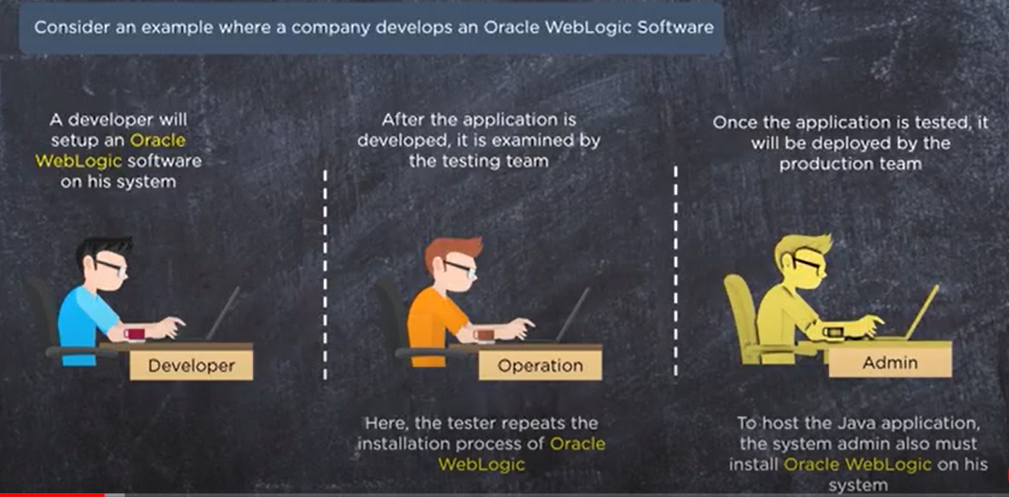
Intro to containerization (docker) Before Containers Companies must deploy their software on VMs or BareMetal , but they were facing a lot of challenges in managing and orchestration of applications , also deploying application on different platforms and moving application from Dev→Staging→Prod , Inconsistence environments & Human error Also problem of maintaining Multi-Host applications and isolation between Applications
Notes:
-Software development & deployment were very slow
-Also repeating similar tasks between environments
-Wasting time
-Wasting resources like employees
-inconsistence environment

Slide 3
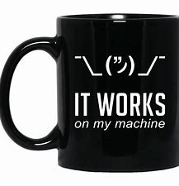
Before Containers
As we noticed in previous example that across 3 env we installed Oracle WebLogic each step in Dev/Stage/Prod this consume a lot of time !!
Also Manual deploying between environment increase the chance of human error and environment inconsistence
brings a lot of fire fighting between Dev & Ops in real world deployments

Slide 4
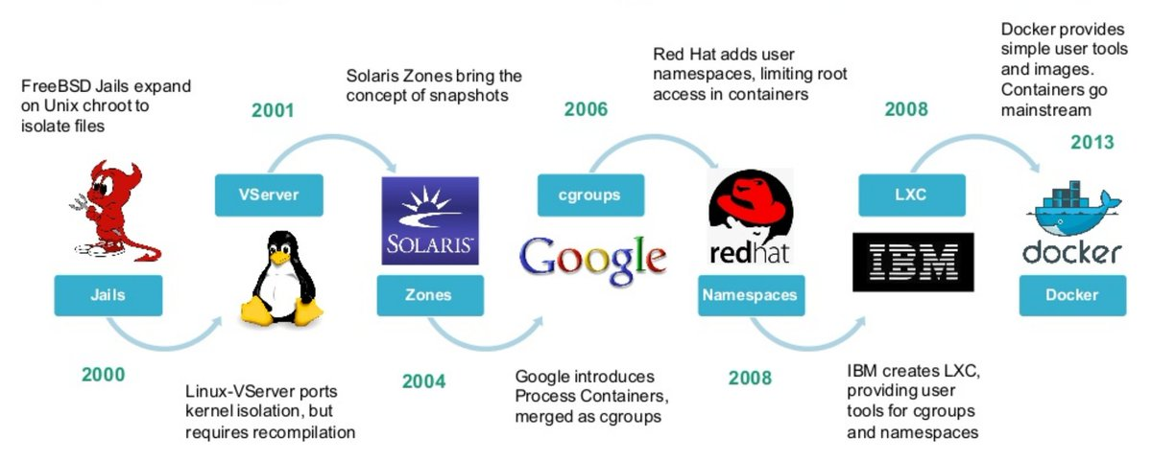
Container History its not new idea
The concept of containerization was introduced back in 1979 with the development of chroot in 1979. Chroot, the process of creating a virtualized environment in a Unix operating system, was added in version 7 of Unix. Chroot marked the beginning of container-style process isolation by restricting an application’s file access to a specific directory — the root — and its children. A key benefit of chroot separation was improved system security, such that an isolated environment could not compromise external systems if an internal vulnerability was exploited
Namespaces and cgroups are the basis of lightweight process virtualization. As such, they form the basis of Linux containers

Slide 5
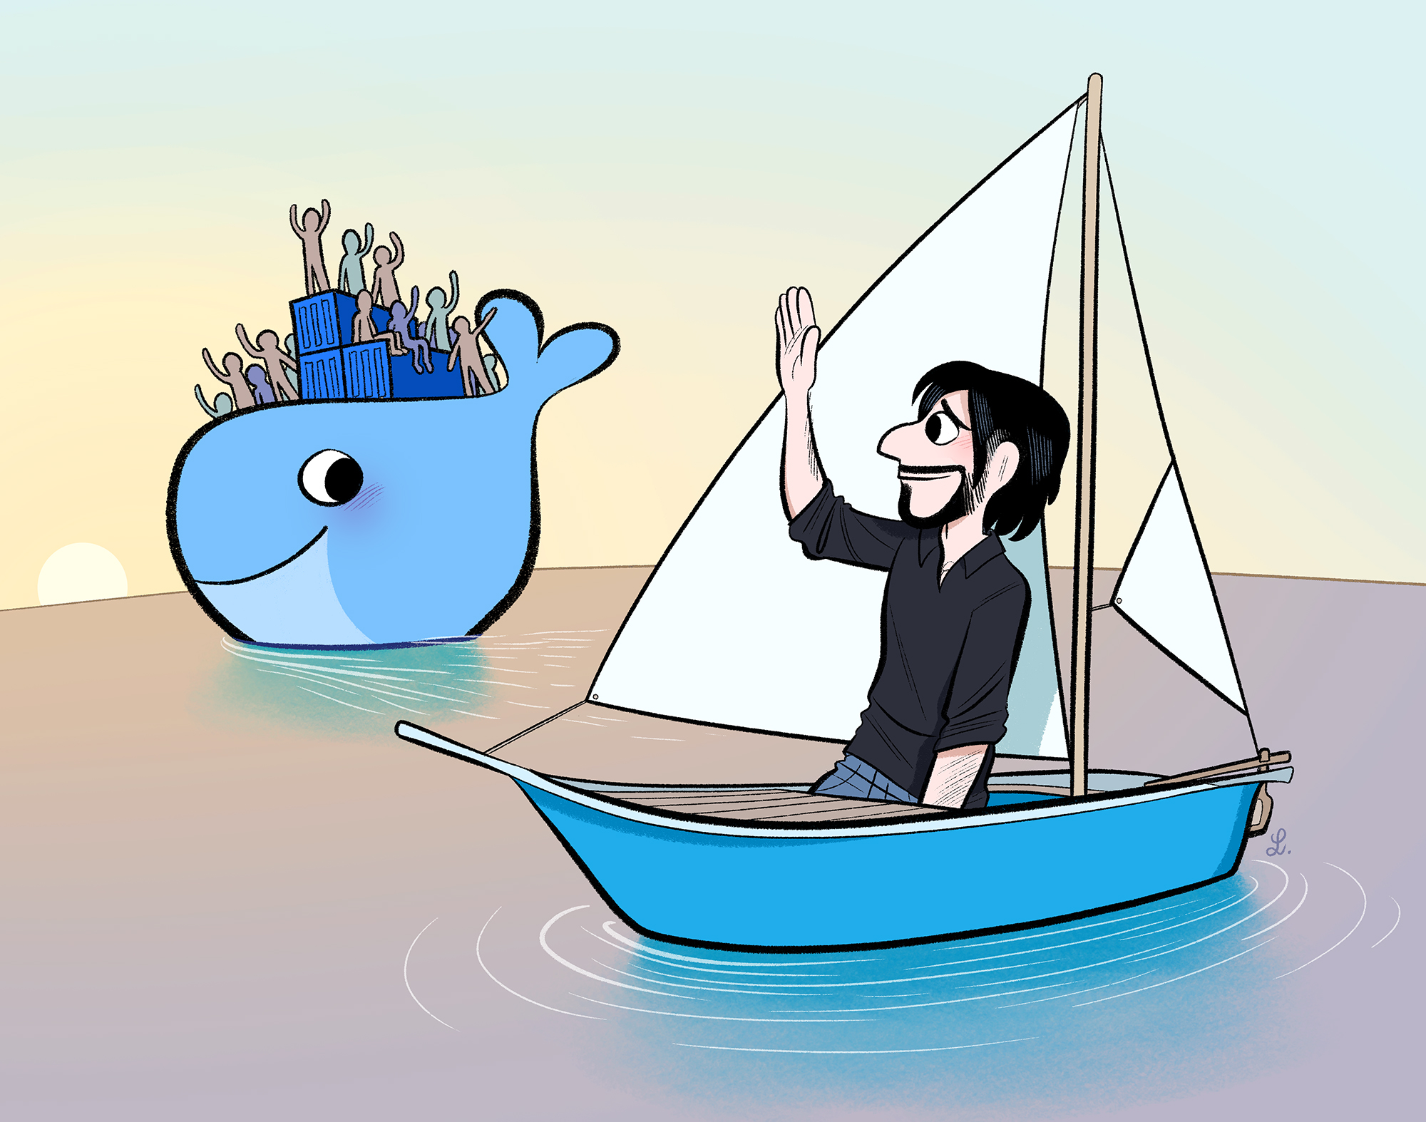
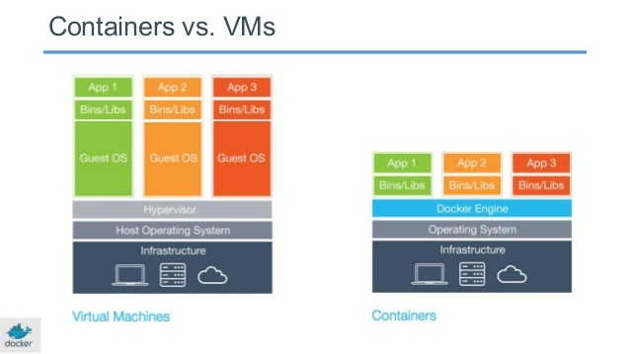
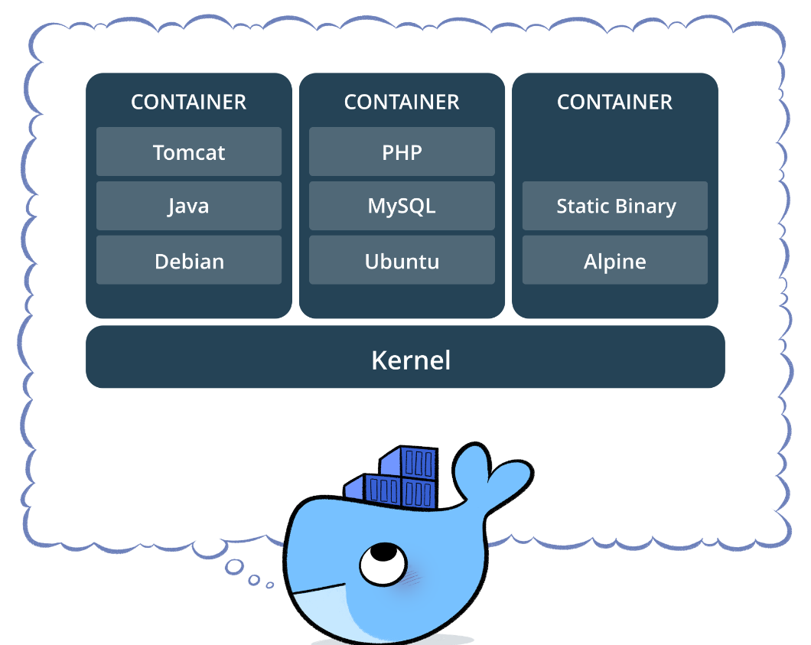
Docker
Isolation • Lightweight
Simplicity • Workflow
Community • Security
Multi-Cloud Platforms (portability) • Cost saving ROI (Infra & Team)
Solomon Hykes creator of Docker , left the company on 2018

Slide 6
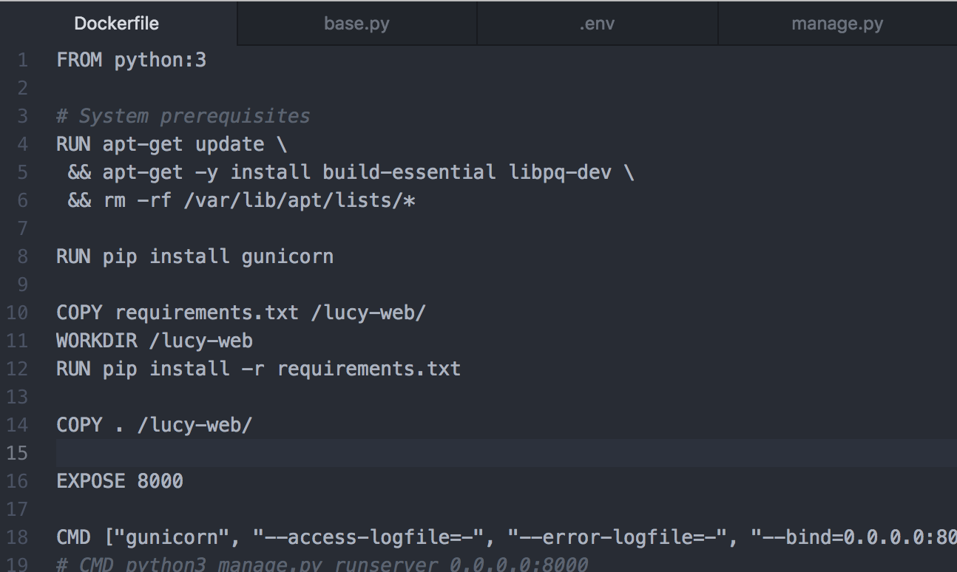
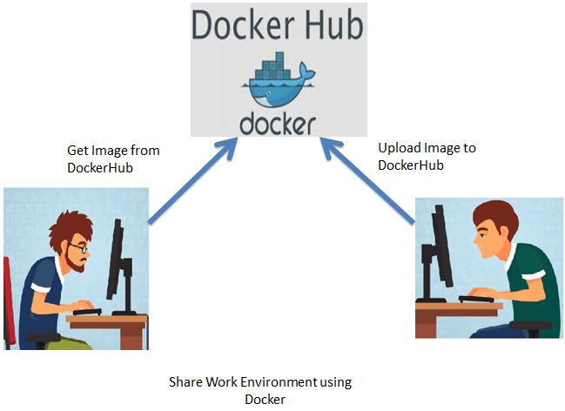
Docker File
Human readable
https://docs.docker.com/develop/develop-images/baseimages/
https://docs.docker.com/develop/develop-images/dockerfile_best-practices/

Slide 7
Intro to Container Orchestrations (K8s) Container orchestration automates the deployment, management, scaling, and networking of containers. Companies that need to deploy and manage hundreds or thousands of Linux®/Windows containers and hosts can benefit from container orchestration.
Tasks performed using container orchestration tools include:
Allocating resources among containers
Scaling containers up and down based on workloads
Routing traffic and balancing loads
Assigning services and applications to specific containers
Deployment and Provisioning
Automating All Above

Slide 8
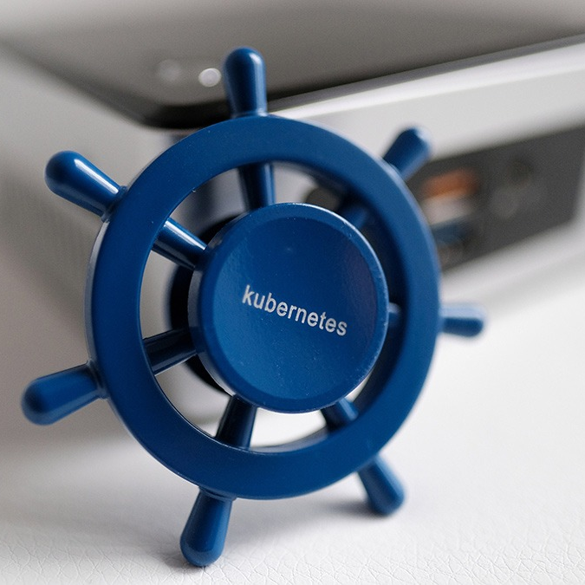
Kubernetes (κυβερνήτης, Greek for "helmsman," "pilot," or "governor", and the etymological root of cybernetics)[6] was first announced by Google in mid-2014.[14] Ville Aikas, Joe Beda, Brendan Burns, and Craig McLuckie were the initial founders of Kubernetes

Slide 9
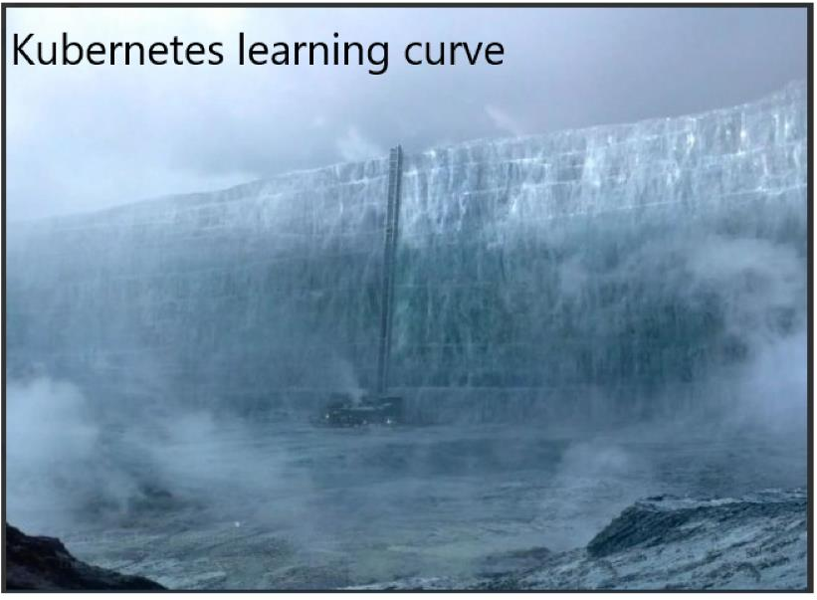


Slide 10
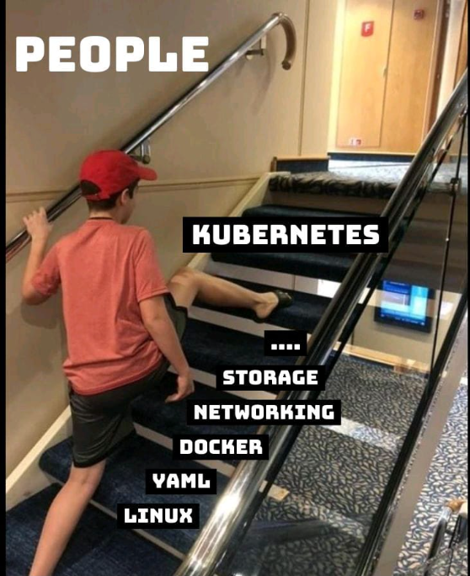

Slide 11
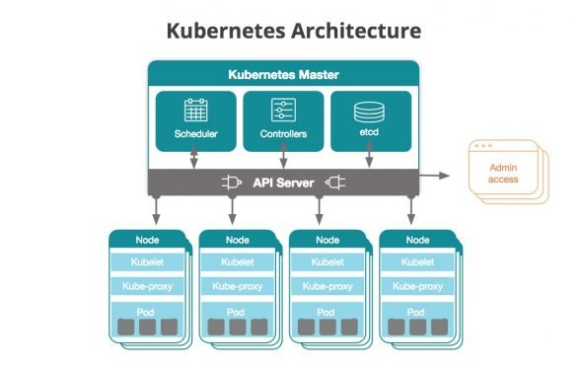
Kubernetes
Kubernetes (commonly stylized as K8s) is an open-source container-orchestration system for automating deployment, scaling and management of containerized applications. It was originally designed by Google and is now maintained by the Cloud Native Computing Foundation CNCF. It aims to provide a “platform for automating deployment, scaling, and operations of application containers across clusters of hosts.
Kubernetes, at its basic level, is a system for running and coordinating containerized applications across a cluster of machines. It is a platform designed to completely manage the life cycle of containerized applications and services using methods that provide predictability, scalability, and high availability.
Master node (API Server)
Worker Nodes
Notes:
https://github.com/kubernetes/Kubernetes one of the most growing project on github

Slide 12
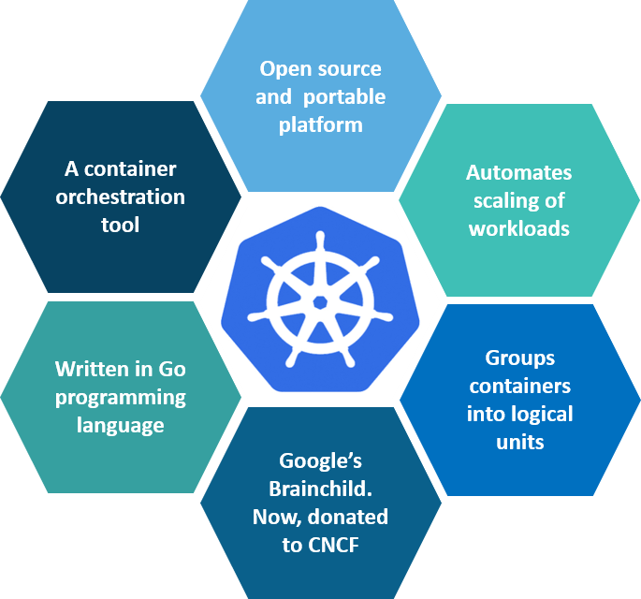
Why K8s
Managing containers for production is challenging. As the container market continued to grow and many workloads transitioned to fully production-grade containers, it was clear cluster admins needed something beyond a container engine. Key capabilities were missing, such as:Using multiple containers with shared resources
Monitoring running containers
Handling dead containers
Moving containers so utilization improves
Autoscaling container instances to handle load
Making the container services easily accessible
Connecting containers to a variety of external data sources
HA and DR also Backup/Restore is easily managed
Notes:
Written in GoLang

Slide 13
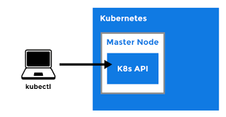
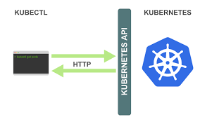
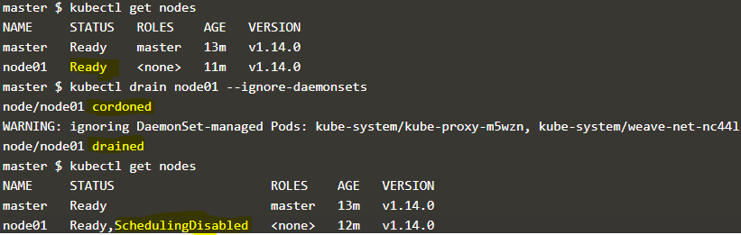
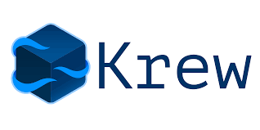
>kubectl
The Kubernetes command-line tool, kubectl, allows you to run commands against Kubernetes clusters.
You can use kubectl to deploy applications, inspect and manage cluster resources, and view logs.
For more information including a complete list of kubectl operations, see the kubectl reference documentation.
https://kubernetes.io/docs/reference/kubectl/cheatsheet/
https://krew.sigs.k8s.io/plugins/

Slide 14
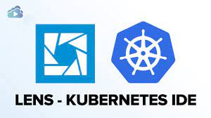
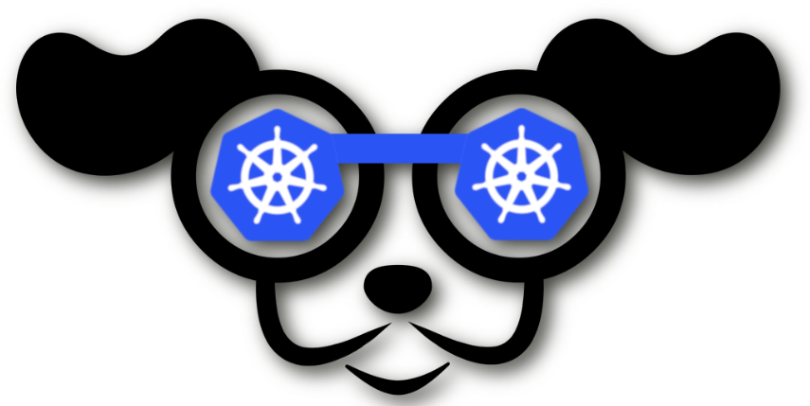
>k9s + lens
https://github.com/MuhammedKalkan/OpenLens
https://k9scli.io/
Notes:
https://alexandre-vazquez.com/openlens-vs-lens/
https://blog.devgenius.io/is-it-time-to-migrate-from-lens-to-openlens-75496e5758d8

Slide 15
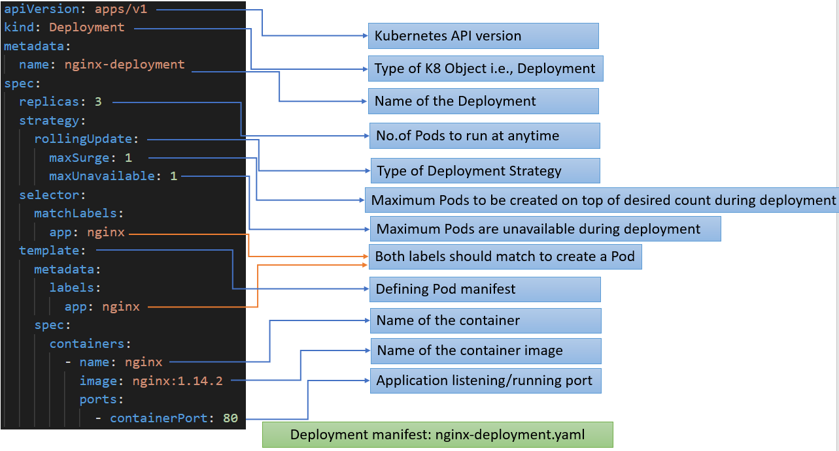
YAML
A Kubernetes user or administrator specifies data in a YAML file, typically to define a Kubernetes object.
The YAML configuration is called a “manifest”, and when it is “applied” to a Kubernetes cluster, Kubernetes creates an object based on the configuration.

Slide 16
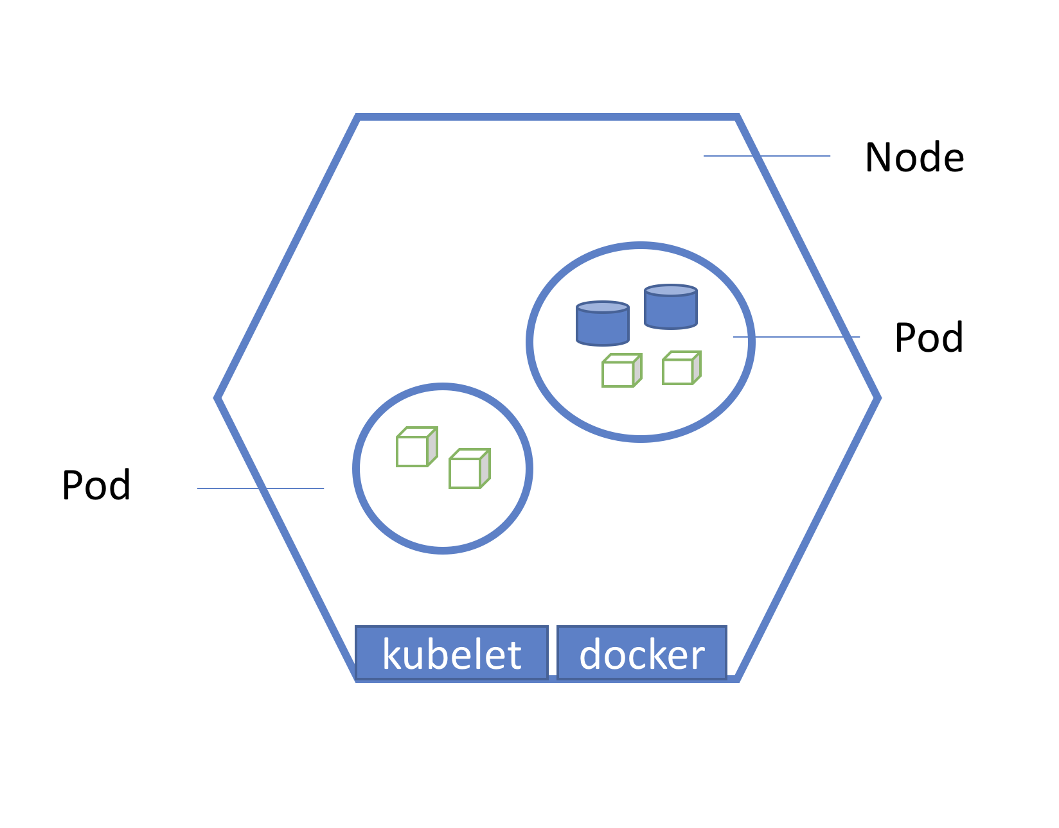
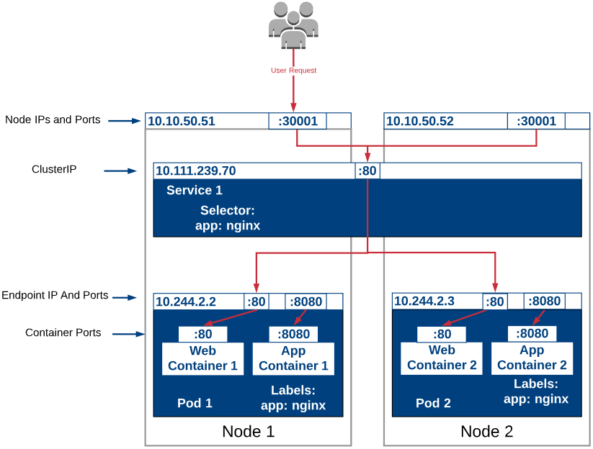
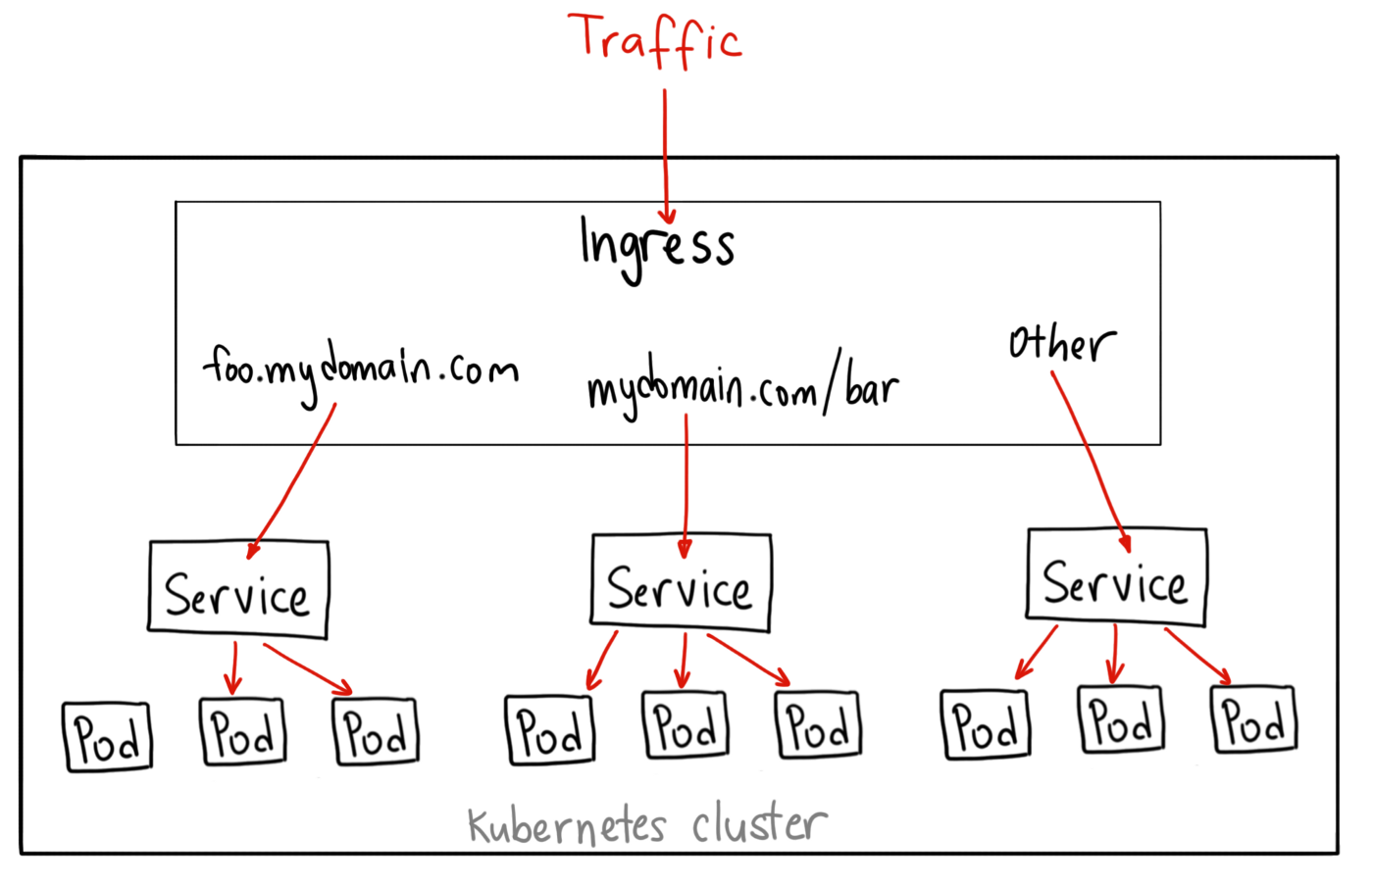
Node|Pod|Deployment|Service|Ingress
Pods are the smallest, most basic deployable objects in Kubernetes, Pods contain one or more containers
Notes:
Mention if 1 pod is failed what will happen

Slide 17
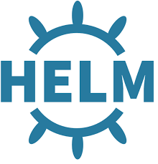
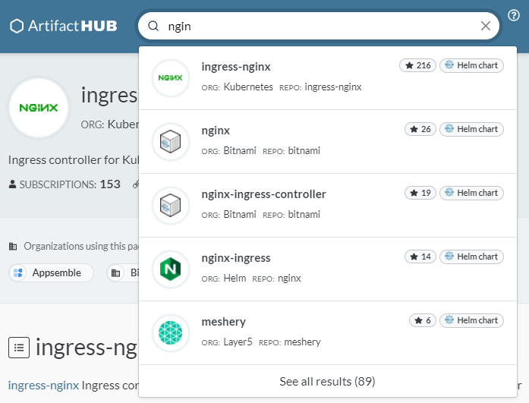
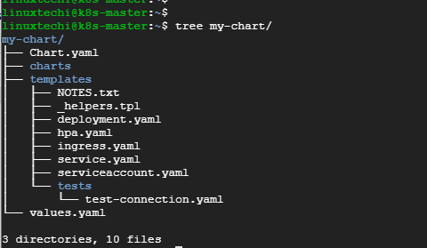
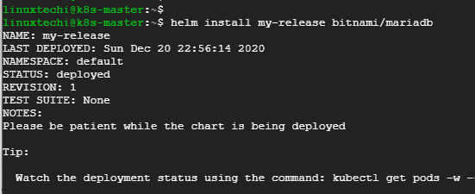
HELM
Helm is CNCF project known as the package manager for Kubernetes is a tool that streamlines installing and managing Kubernetes applications. Think of it like apt/yum/homebrew for Kubernetes.
Helm is the best way to find, share, and use software built for Kubernetes.
helm repo add bitnami https://charts.bitnami.com/bitnami
helm repo update
helm install bitnami/mysql --generate-name
helm list
helm uninstall mysql-1612624192

Slide 18


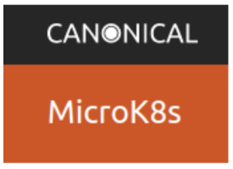
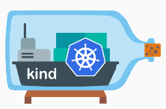

Run K8s locally
https://github.com/kelseyhightower/kubernetes-the-hard-way
Kubernetes installation is hard process , that’s why there are many simple k8s installation for testing
And learning use ,the best option is to use Cloud Managed Kubernetes like AKS,EKS or GKE
https://thechief.io/c/editorial/k3d-vs-k3s-vs-kind-vs-microk8s-vs-minikube/
Project Name | URL
minikube | https://minikube.sigs.k8s.io/docs/start/
K3s | https://k3s.io/
Kind | https://kind.sigs.k8s.io/
MicroK8S (Canonical) | https://microk8s.io/
Notes:
https://ubuntu.com/tutorials/how-to-kubernetes-cluster-on-raspberry-pi
https://thechief.io/c/editorial/k3d-vs-k3s-vs-kind-vs-microk8s-vs-minikube/

Slide 19
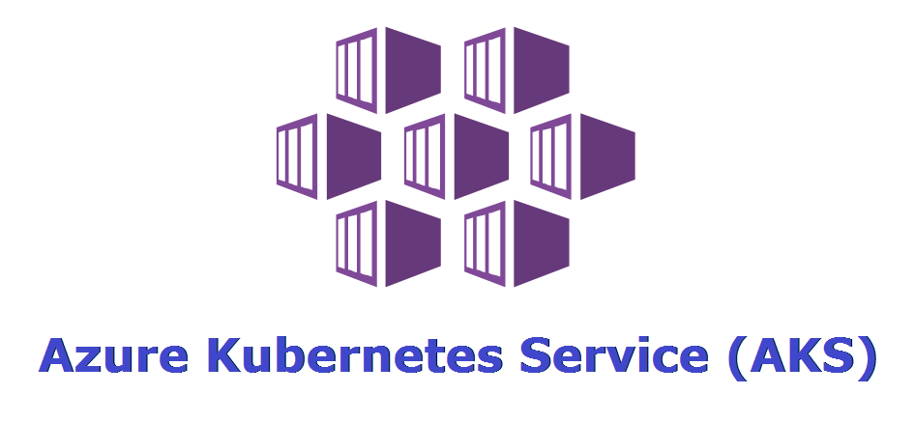
Azure Kubernetes Service (AKS) is a managed container orchestration service, based on the open source Kubernetes system, which is available on the Microsoft Azure public cloud. An organization can use AKS to deploy, scale and manage Docker containers and container-based applications across a cluster of container hosts.
AKS became generally available in June 2018.
1.24 is latest GA version
Notes:
-Its Microsoft Azure offering for K8s , its managed and one of the vast growing projects in terms of customer adoptions in Azure

Slide 20
AKS Demo
Notes:
Create AKS cluster and deploy sample APP

Slide 21
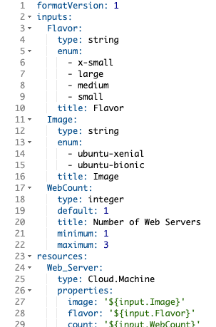
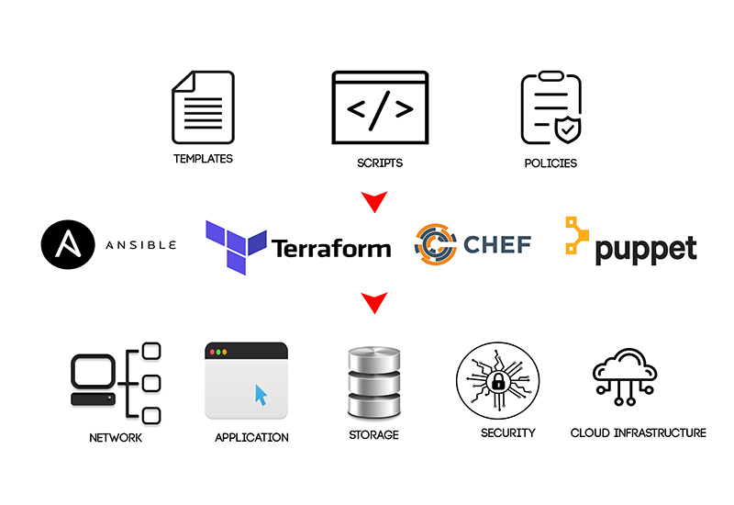
Infra Structure as Code (IaC)
Infrastructure as Code (IaC) is the management of infrastructure (networks, virtual machines, load balancers, and connection topology) in a descriptive model, using the same versioning as DevOps team uses for source code. Like the principle that the same source code generates the same binary, an IaC model generates the same environment every time it is applied. IaC is a key DevOps practice and is used in conjunction with continuous delivery.
it makes environments more predictable

Slide 22
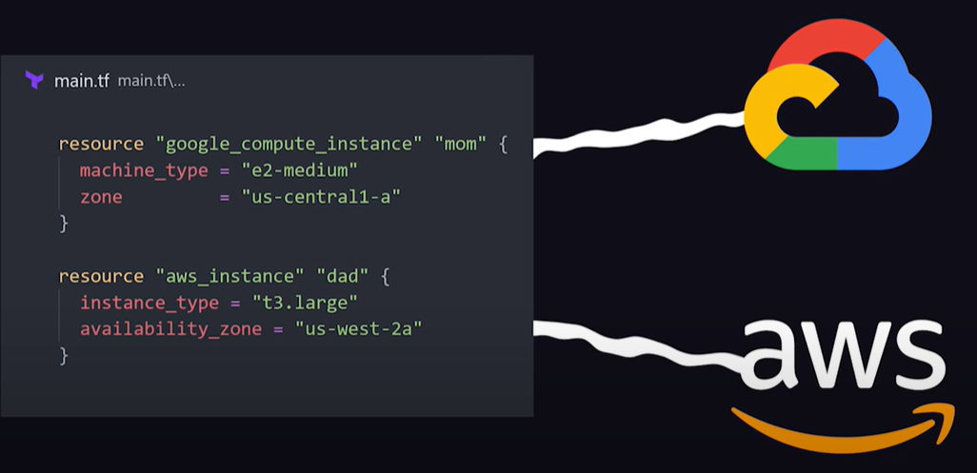

Terraform is an open source “Infrastructure as Code” tool,
created by HashiCorp. Written in Go Lang
Mostly used in Cloud
A declarative coding tool, Terraform enables developers to use a high-level configuration language called HCL (HashiCorp Configuration Language) to describe the desired “end-state” cloud or on-premises infrastructure for running an application.
It then generates a plan for reaching that end-state and executes the plan to provision the infrastructure.
https://www.youtube.com/watch?v=tomUWcQ0P3k
Terraform keep track of changes (diff) like Git , if you run terraform apply again it will check for changes and do it
Current state Vs desired state

Slide 23
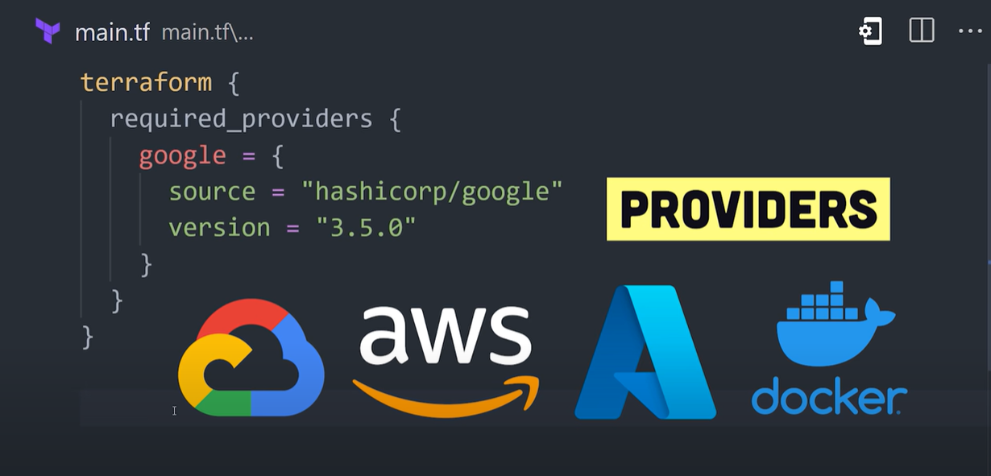
Providers
https://registry.terraform.io/browse/providers

Slide 24
Command
$ terraform init | to tell Terraform to scan the code, figure out which providers you’re using, and download the code for them
$ terraform plan | lets you see what Terraform will do before actually making any changes. This is a great way to sanity-check your code before unleashing it onto the world. The output of the plan command is similar to the output of the diff command that is part of Unix, Also like dry run
$ terraform apply | command shows you the same plan output and asks you to confirm whether you actually want to proceed with this plan
$ terraform destroy | This will destroy all managed infra structure its reverse of apply

Slide 25
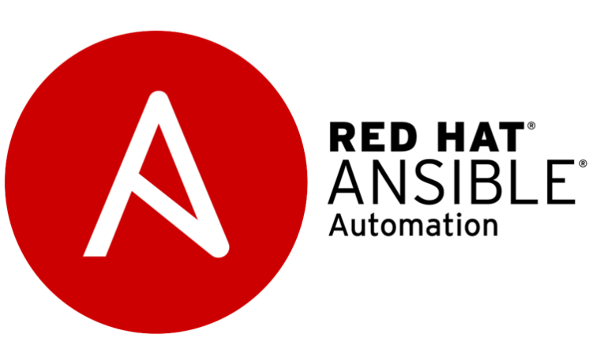
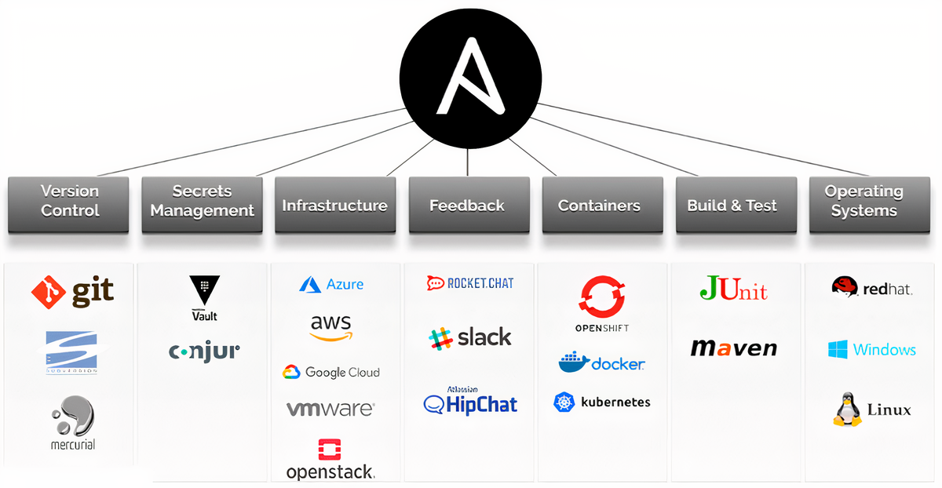
Ansible is a IT Automation tool that is used for CLoud Provisioning, configuration management, and application deployment and many more IT needs. It is the open source software that provide us infrastructure as code. It is very easily to use and manage every one can understand with in one day what is ansible and how to use. we can use it in Linux as well as Windows.
Based on Python and its agentless
Current state Vs desired state

Slide 26
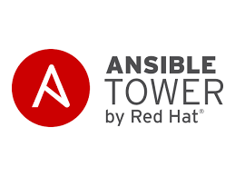
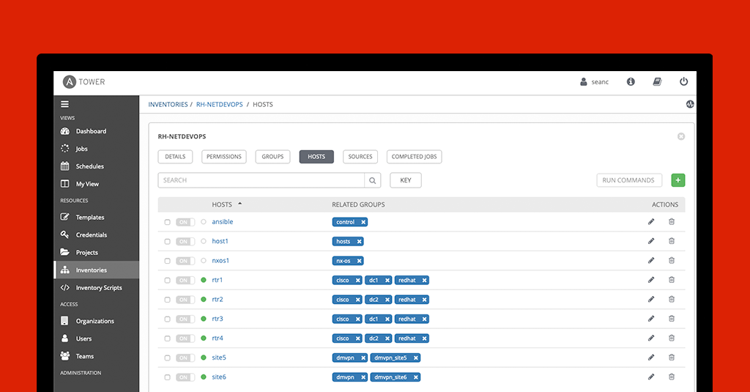
Ansible Tower:
Ansible tower is the Web-based solution that helps us to manage team and complex multi-tier architecture. It is the made for organizing management and it provides a dashboard with state summaries of all the hosts, allows quick deployments, and monitors all configurations.

Slide 27
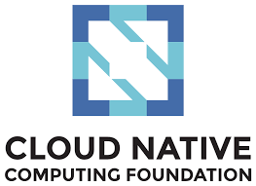
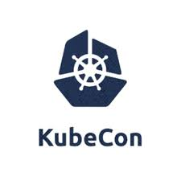
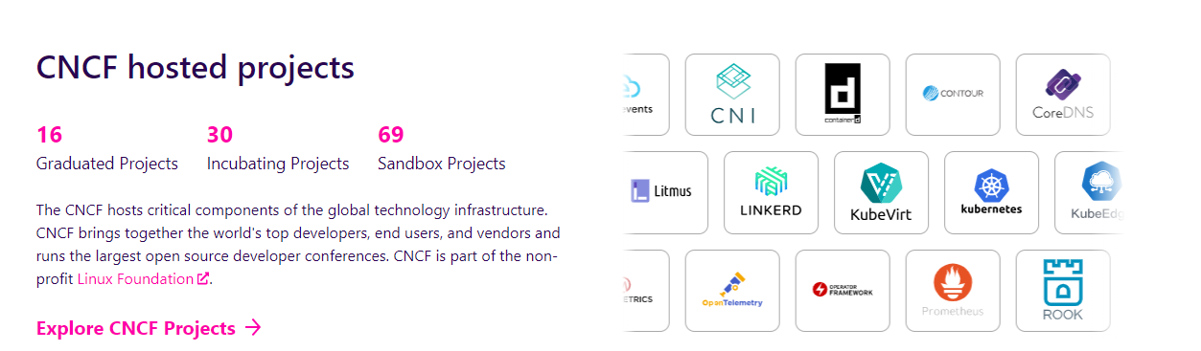
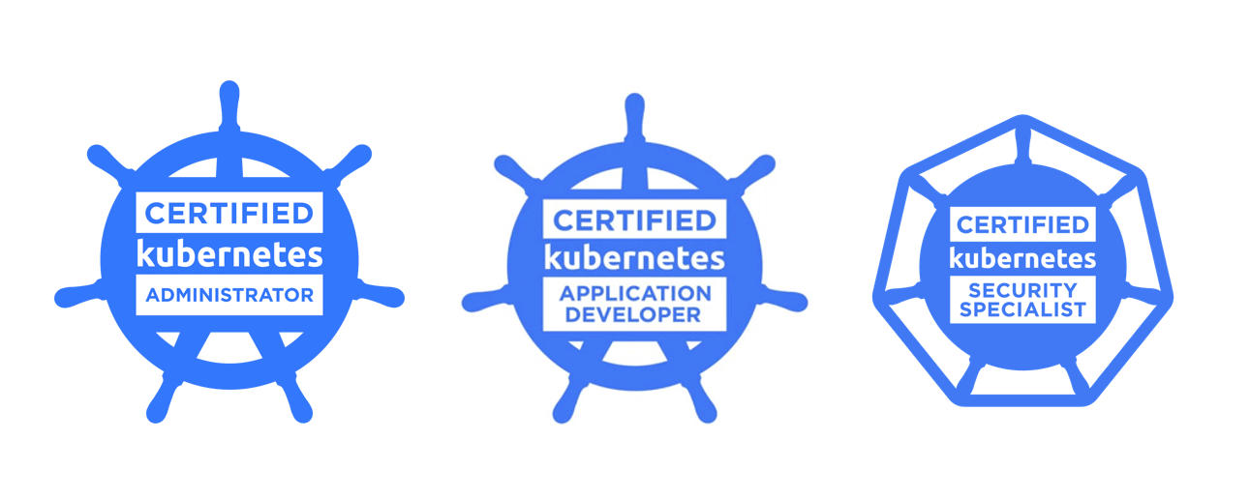
CNCF
Building sustainable ecosystems for cloud native software
149K+Contributors
7.6M+Contributions
187+Countries
Cloud Native Computing Foundation (CNCF) serves as the vendor-neutral home for many of the fastest-growing open source projects, including Kubernetes, Prometheus, and Envoy.

Slide 28
Demo Terraform + Ansible

Slide 29
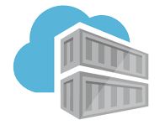
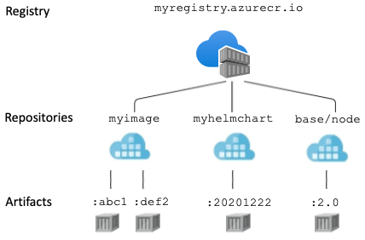
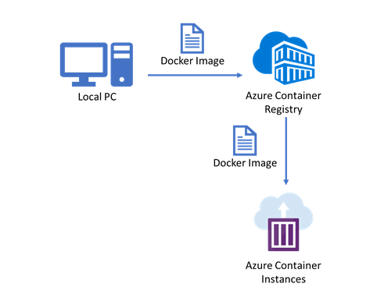
ACR Azure Container Registry
Azure Container Registry allows you to build, store, and manage container images and artifacts in a private registry for all types of container deployments. Use Azure container registries with your existing container development and deployment pipelines. Use Azure Container Registry Tasks to build container images in Azure on-demand, or automate builds triggered by source code updates, updates to a container's base image, or timers.
Azure Container Registry is a managed, private Docker registry service based on the open-source Docker Registry 2.0. Create and maintain Azure container registries to store and manage your private Docker container images and related artifacts.

Slide 30
Useful links
Title
Kubernetes: The Documentary [PART 1] | https://www.youtube.com/watch?v=BE77h7dmoQU
Kubernetes: The Documentary [PART 2] | https://www.youtube.com/watch?v=318elIq37PE
50 days from zero to hero with Kubernetes | https://azure.microsoft.com/mediahandler/files/resourcefiles/kubernetes-learning-path/Kubernetes%20Learning%20Path_Version%202.0.pdf
Kubernetes Basics with Brendan Burns | https://www.youtube.com/playlist?list=PLLasX02E8BPCrIhFrc_ZiINhbRkYMKdPT
Kubernetes Crash Course for Absolute Beginners [NEW] With Nana | https://www.youtube.com/watch?v=s_o8dwzRlu4 https://www.youtube.com/watch?v=X48VuDVv0do
محمد الدسوقى ِ Ansbile في العربي | https://www.youtube.com/watch?v=dNJg3GrWDLg&list=PLOeEp3fYj7rojjhsYYgtM_iOOaPnigrmT
Complete Terraform Course | https://www.youtube.com/watch?v=7xngnjfIlK4

Slide 31
Q & A

